Slide 1
Flexibility Opportunities for Schools and Corporations

Slide 2
1003 Flexibility Waivers
Summary (IC 20-31-4.1)
• Schools/groups of schools may request that the State Board of Education (SBOE) waives compliance with any provision in Title 20 or 511 IAC (unless on list of non-waivable provisions)
• Request must be tied to…
Improvement of student performance & outcomes;
Flexibility in administration of educational program/improvement of efficiency in school operations;
Promotion of innovative educational approaches to student learning; or
Advancement of the mission/purpose of the school/group of schools

Slide 3
1003 Flexibility Waivers
About 43% of non-conditional mandates are eligible for a “1003” waiver.
96
Waivable Requirements
129
Non-Waivable Requirements
225
Total Requirements

Slide 4

1003 Flexibility Waivers
The purpose of this waiver is to promote innovative approaches to student learning and enhance student performance outcomes.
What specific goals or outcomes will be achieved by waiving the provision?
  enhance student learning opportunities?
  promote innovation?
  increase equitable access to effective teachers?
How will data and benchmarks be used to measure and monitor student performance outcomes?
Notes:
A school or group of schools can submit requests for multiple provisions to be waived.
When deciding if your school or school corporation would benefit from a “1003” Flexibility Waiver, consider the following:

Slide 5
1003 Flexibility Waivers
Process
•March – June: Submit waiver request application
•March – June: IDOE reviews and provides recommendation to SBOE
•May – July : SBOE makes final determination
•SBOE periodically reviews compliance with waivers and may amend, suspend, or revoke an approved waiver if goals are not met.

Slide 6
1003 Flexibility Waivers
Requirements
•Identify provisions being requested to waive.
•Provide the specific goal/outcome intended to be achieved by waiving the provision/s.
•Provide how the specific goal/outcome are likely to be achieved by waiving the provision/s.
•Present data benchmarks and metrics used to measure achievement of specific goal/outcome.
•Pass a resolution from the school’s governing body approving the waiver request.

Slide 7
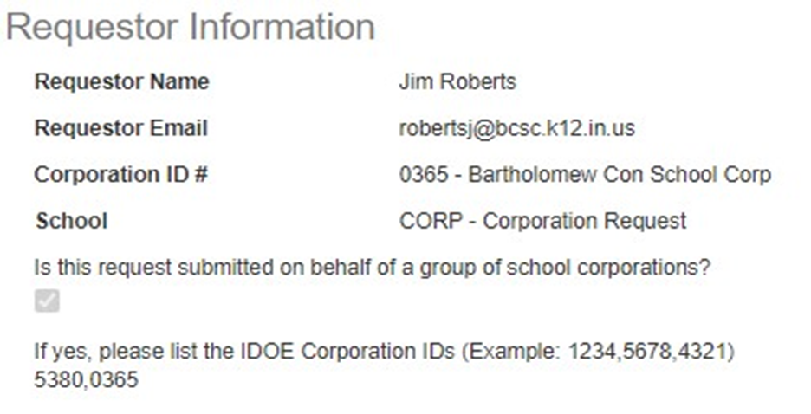
1003 Flexibility Waivers
Submission Form Contents

Slide 8
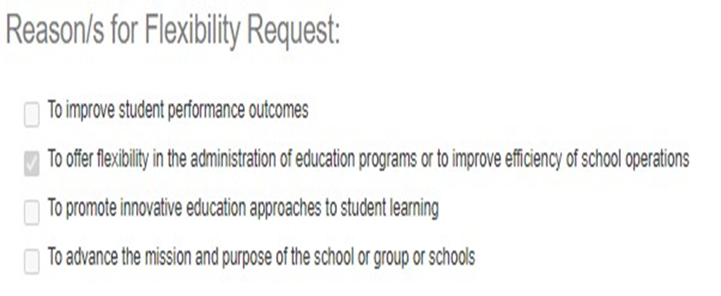
1003 Flexibility Waivers
Submission Form Contents

Slide 9
1003 Flexibility Waivers–Example Application
Statute/Regulation | Goal/Outcome | How to Achieve | Data/Benchmarks
IC 20-30-2-3 | To facilitate district goals and initiatives, the group would like to request flexibility in instructional days requirements by having three professional development days (one each quarter for the first three quarters) during the school year to provide staff with opportunities to create scope and sequence charters, collaborate in and across grade levels/subjects, and to continue to refine the practice of in-process initiatives. Therefore, the student instructional year would consist of one hundred seventy-seven (177) days. 1. In grades K-8, students will: a. Show or exceed typical growth on NWEA Reading RIT scores from fall to spring testing sessions and b. for those in the testing cohort two consecutive years at the group, grow in the percent of students passing ILEARN reading by an average of 5% from the previous year tested. 2. The group’s high school will improve its diploma strength by 3% in two years. | During three professional development days, staff will receive additional training, coaching, and collaboration time in addition to time during weekly after-school meetings in the listed activities. In grades K-2 continued professional development in: a. Orton-Gillingham approach implementation, b. Fountas and Pinnell classroom and guided reading, c. Reveal Math, and d. Scope and sequence charts for ELA and math. In grades 3-5, continued professional development in: a. Fountas and Pinnell classroom and guided reading, b. Reveal Math, and c. Scope and sequence charts for ELA and math. In grades 6-8, continued professional development in: a. Adopting an ELA instructional curriculum; b. Illustrative Mathematics curricula and on-going peer coaching, and c. Scope and sequence charts for ELA, science, social studies, and math. In grades 9-12, continued professional development in: a. Scope and sequence charts for all subjects and courses using Understanding by Design model. b. Best practice instructional models by subject area, c. Content area integration of SAT preparation strategies, and d. Continued development of college and career readiness initiatives. | Leading Measures: 1. NWEA Phonemic Awareness Screeners (K-2) 2. Winter NWEA scores (K-8) 3. BAS Scores (K-5) 4. F & P Guided Reading Levels (K-5) 5. Illustrative (6-8) and Reveal (K-5) Math formative assessments 6. Summative assessment averages (6-8 and HS) 7. PSAT Scores (HS) Lagging Measures: 1. iREAD 3 Scores 2. ILEARN ELA and Math Scores 3. Spring NWEA Scores 4. SAT Scores for juniors 5. Graduation Rate 6. Diploma Strength 7. College and Career Readiness Index

Slide 10
1003 Flexibility Waivers–Example Application
Statute/Regulation | Goal/Outcome | How to Achieve | Data/Benchmarks
IC 20-30-2-3 | Learning gaps are a negative consequence of COVID 19 that will take years to recover from. By utilizing a flex waiver for minutes vs. 180 days of instruction, the group can provide staff professional development to address the needs of students. One specific outcome we intend to achieve by waiving this provision includes lengthening the time we will be able to meet for in-person learning to maximize instructional time. 1. Reach 80 percent model attendance rate by June 1, 2022. 2. Establish Tier I and Tier II academic intervention programming within the developing MTSS plan. 3. Increase percentage of students reaching proficient rating on formative and summative assessments by three percent. | By utilizing flex days to provide professional development to staff, the group is able to bring all staff together at one time to provide intense, succinct, and timely training. This means that the group can begin to quickly meet the needs of students instead of a slower pace model reliant on non-existent subs. This model allows staff members the opportunity to solely focus on the professional development without the added responsibilities of creating substitute lesson plans, eLearning lessons, and managing student needs at the same time as they attempt to attend to their own learning. | Learning gap data is collected from a variety of student assessments and daily student performance. With more professional development and supports in place for students we expect to see lower numbers of absences and higher academic performance. Data collection includes: 1. Daily attendance rate for students. 2. Implementation of Tier I and Tier II programming. 3. Scores from Fountas and Pinnell, ILEARN, ISTEP, NWEA, Ready Math, IAM, and SAT.

Slide 11
1003 Flexibility Waivers-statutes granted flexibility
Statute | Granted Flexibility
IC 20-20-8 | •Do not have to publish APR in the newspaper
IC 20-26-18 | •Do not establish or publish a written policy to address criminal organizations & activity in school •Do not establish evidence-based educational criminal organization awareness for students, employees & parents •Do not develop program to provide training to employees on implementation of criminal organization policy •Do not submit written report to DOE on activities undertaken by corporation
IC 20-30-2-2 | •Allowed to have quarterly two-hour delays for professional development
IC 20-30-2-3 | •Allowed to track instructional time in minutes instead of hours for school year

Slide 12
1003 Flexibility Waivers-Statutes Denied Flexibility
Statute | Denied Flexibility
IC 20-19-9-1 | •Waive definition of “virtual program”
IC 20-19-9-4 | •Waive requirements for establishing a virtual school
IC 20-20-40-13 | •Waive requirements of seclusion & restraint plan and training
IC 20-26-5-34.2 | •Waive requirements for bullying training
IC 20-26-5-34.4 | •Waive requirements for child suicide awareness & prevention policy
IC 20-26-16-4 | •Waive requirements for school corporation police department training

Slide 13
1003 Flexibility Waivers-Statutes Denied Flexibility
Statute/Reg | Denied Flexibility
IC 20-30-2-1 | •Waive definition of “instructional time”
IC 20-32-8.5 | •Waive IREAD-3 assessment administration
IC 20-33-2-3.2 | •Waive definition of “attend”
IC 20-33-2-14 | •Waive attendance/absence requirements in light of COVID-19
IC 20-36 | •Waive use of DOE’s preferred general intellectual testing for high ability identification & use NWEA/locally developed assessments
511 IAC 6.2-3-1 | •Waive IREAD-3 assessment administration

Slide 14
1003 Flexibility Waivers
Common Mistakes and Application Deficiencies
Request is not related to specific goal or outcome
Insufficient rationale
Waiver is unlikely to improve student performance outcomes, offer flexibility in administration of educational programs, improve efficiency of school operations, promote innovative approaches to student learning, or advance the mission or purpose of the school or group of schools
Provision is unwaivable

Slide 15
Questions?
schoolimprovement@doe.in.gov

Slide 16
Thank you!

